Slide 1
Tęstinis integravimas ir testavimas
Dr. Asta Slotkienė

Slide 2
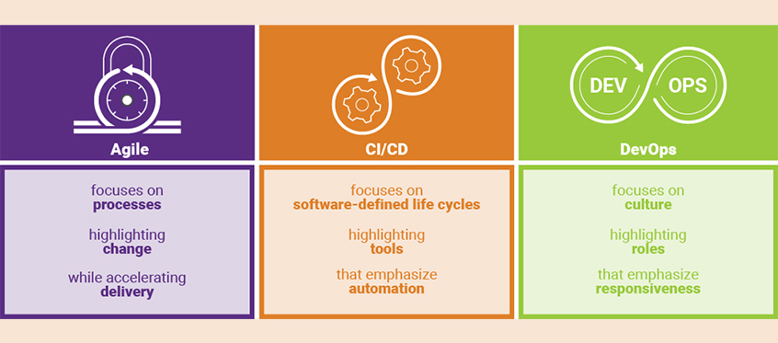
The difference between agile, CI/CD, and DevOps

Slide 3
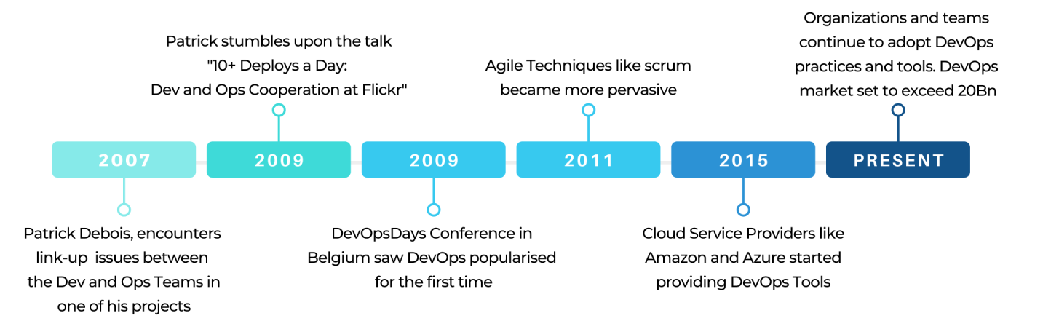
DevOps History
Concept of DevOps emerged out of a discussion between Andrew Clayand Patrick Deboisin 2008.
https://www.appknox.com/blog/history-of-devops
Agile Development->Agile Development

Slide 4
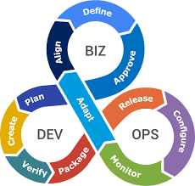
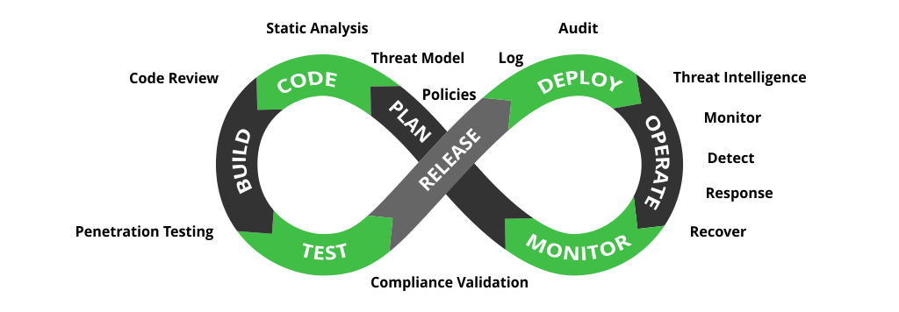
Nowadays
DevOps,
BizDevOps,
DevOpsSecs
AIOps
GitOps
CloudOps
MLOps
...

Slide 5
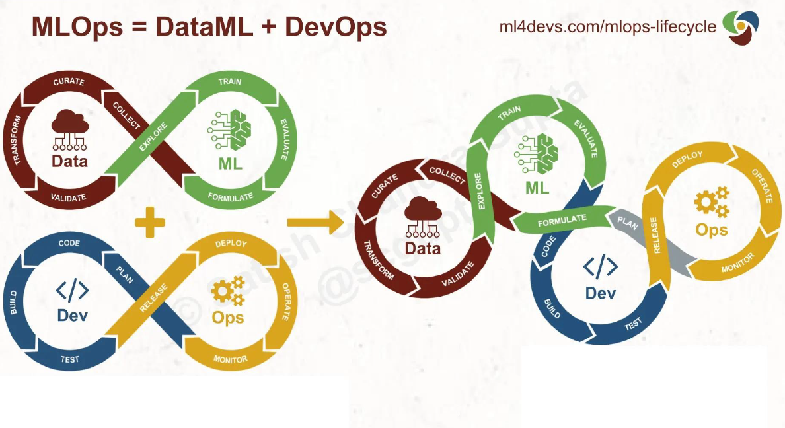
From Ops to DevOps to MLDevOps
https://www.ml4devs.com/articles/mlops-machine-learning-life-cycle/

Slide 6
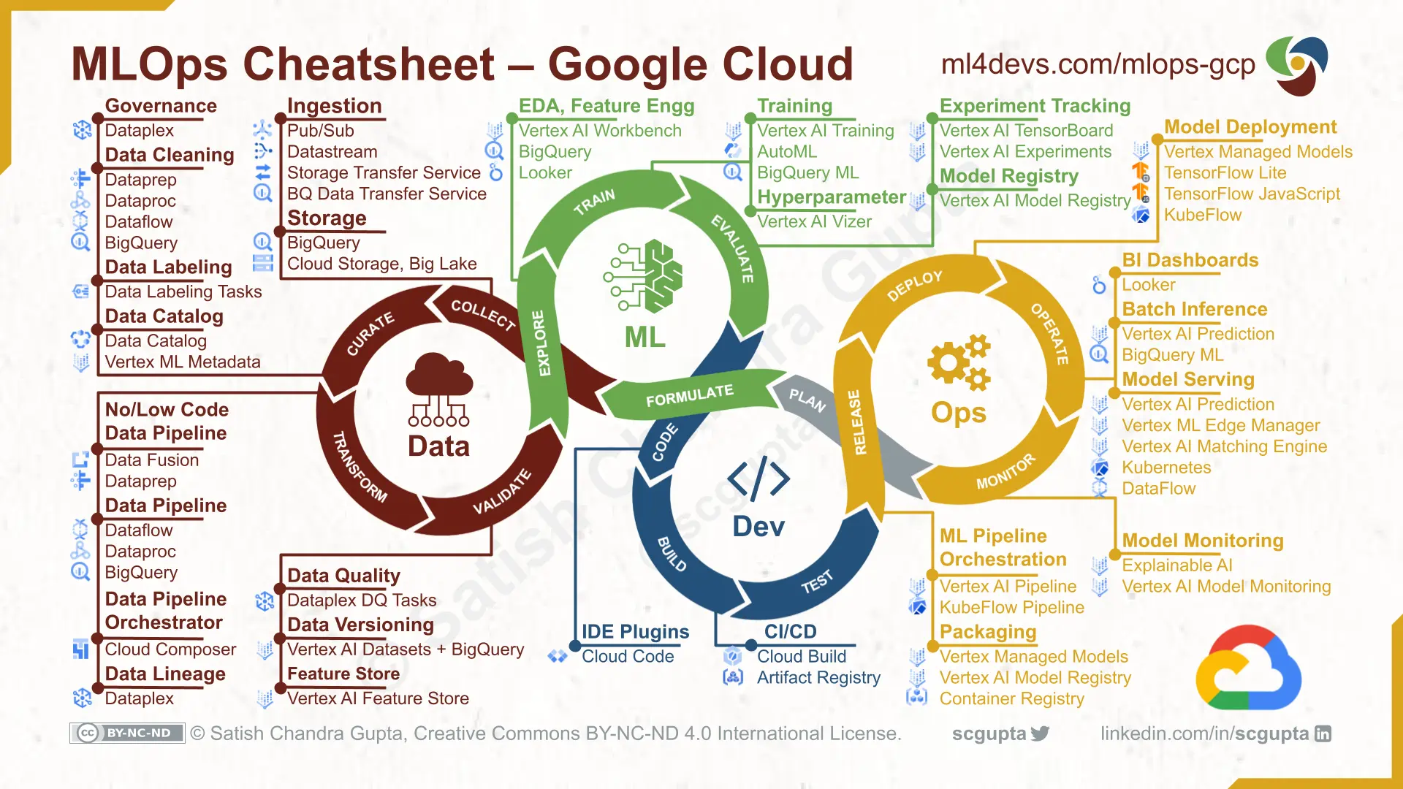
MLDevOps

Slide 7
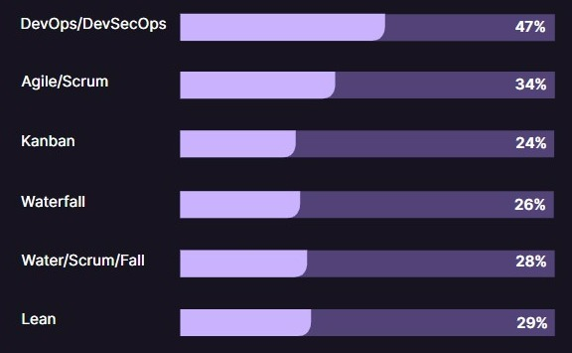
Most Practiced Development Methodologies
https://bit.ly/3ZAWEFp

Slide 8
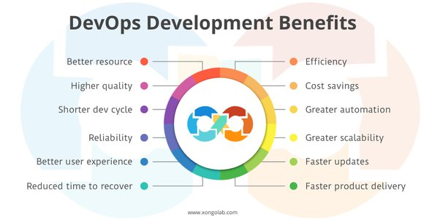
What is DevOps and why
DevOps is a set of practices that combines software development(Dev) and IT operations(Ops).
It aims to shorten the systems development life cycle and provide continuous delivery with high software quality.

Slide 9
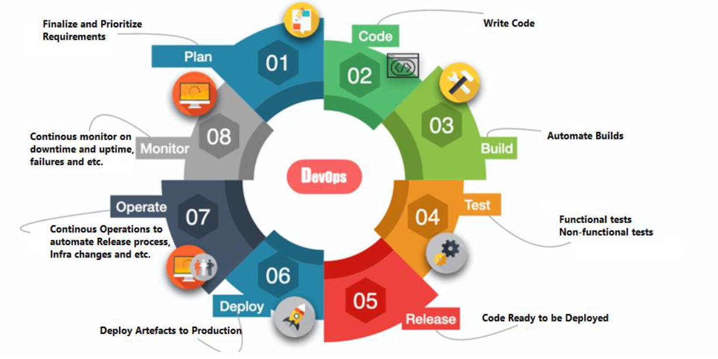
DevOps cycle

Slide 10
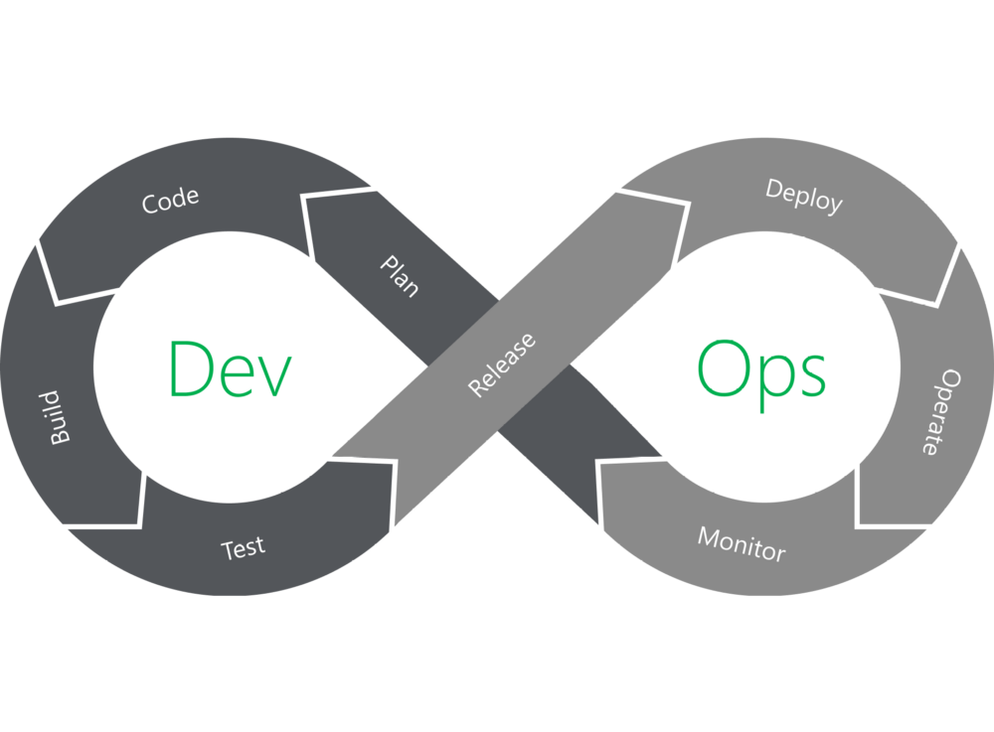
DevOps
PLAN: reikalavimų inžinerija/projektavimas
CODE: užduočių programavimas, talpinimas į projekto saugyklą
Notes:
PLAN: viskas kas vyksta pries pradedant rasyt koda,
CODE: rasom koda ir komitinam I I centrine kodo repozitorija Need to have a Vision -> goal for all participants
Idea -> Planning -> Strategy -> Success
What are the thing that should be in the agenda/mind:
•customer, client,
•software requirement,
•enhancement request, bug fix, line-of-business,
•features, idea
Break work down into smaller, manageable chunks for quicker deployments
Addresses
changes and evolutions according to a continuous improvement process and continuous feedback.
Requirements:
Training on tools and metrics in order to have enough visibility of the project’s development.
Here you mainly
-write code
Use of plugins to
•consistent code-styling
•avoid common security flaws
•Avoid code anti-patterns (e.g. no proper modularize, one solution for all problem, dead code –not sure what it does, unnecessary code/modules/classes, etc).
Several VCS for maintaining the
•codes
•designing infrastructure,
•automating processes,
•defining tests
•implementing security

Slide 11
DevOps
BUILD: talpinant kodą į saugyklą, automatiškai sukompiliuojama, paleidžia testus, tikrina kokybę ir paruošia image
TEST: rankinio/automatinio testavimo vykdymas testinėje aplinkoje
Notes:
BUILD: kai koda comitinam i repo, pasileidzia buildas, kuris subuildina koda, runina ivairius testus, security/quality scanus ir paruosia image TEST: manual arba automatiniu testu atlikimo stage + gali buti infra as a code
A test can be:
•Scripted (e.g. test case or automated test) or exploratory
•scenario based testing
•Executed manually or through automation
•Linked to/cover one or more requirements
•Like any other Jira issue type, it can be labeled, prioritized, assigned to components, and commented on
•Use of test environment
Types of tests:
•unit tests,
•integration tests,
•functional tests,
•end-to-end tests,
•acceptance tests,
•performance tests,
•and smoke tests.

Slide 12
DevOps
RELEASE: išleidimas PS versijos/fukcionalumo. Išleidimo visos užduotys DoD. Papildomai gali reikti dokumentacijos parengimo, išorinių suinteresuotų asmenų patvirtinimo
DEPLOY: perkėlimas į produkcinę aplinką, kai funkcionuoja skirtingose aplinkose, platformose, kontekstuose
Notes:
RELEASE: stadija kai visi testai done ir kodas ready deploymentui. Priklausomai nuo imones sitojs stadijos gali reikes approval, change request, dokumentacijos arba tiesiog sulaukt release” window
DEPLOY: pakeitimai keliauja i PROD
You basically deploy the product on a production environment
Product is ready for
•different deployment contexts
•different deployment environments
•different deployment platforms

Slide 13
DevOps
OPERATE:
PS realizacija funkcionuoja produkcinėje aplinkoje
Konfigūracijų valdymas
Plečiamumo ir load time stebėjimas
MONITOR:
fiksuojamas/stebimas PS funkcionavimas ir nefunkciniai reikalavimai, ypač našumas/saugumas/prieinamumas/patikimumas
analizuojami „bottlenecks“ ir sprendžiama dėl atnaujinimų funkcionalumą arba nefunkcinių reikalavimų
Renkama end-user grįžtamasis ryšys
Notes:
OPERATE: Stebim kad pakeitimai sekmingai suktusi, kad butu geras tiek appso tie infros performance, kad infra butu up, autoscale, maintenance.
MONITOR: nors ir paskutinis, bet vyksta visada, tam kad nustatyti kur yra bottlenecks, ka galima improvinti ir pan
Operate:
The product live in production environment
Operations team relies on automated tools wherever possible for
•configuration management
•scaling
•load balancing
Monitor:
Monitor the environments
•Capturing metrics describing the software’s performance.
•Collects customers’ feedback on their experiences
•analytics on customer behavior
•performance, errors and more
•Monitor the DevOps pipeline itself
LTAT.

Slide 14
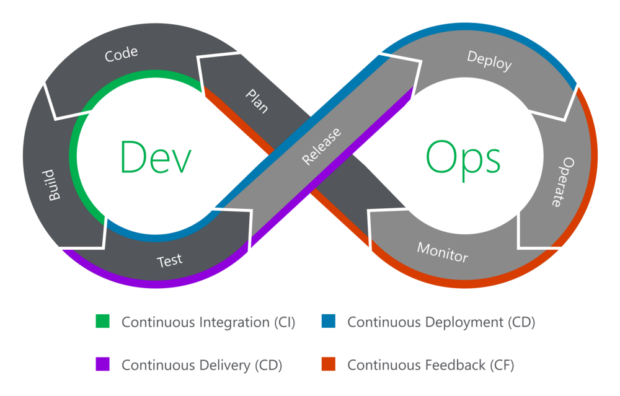
Notes:
Continuous Everything
CI-CD neatsiejama devops dalis.
CI - Apjungia code ir build dalis, naudojam centralizuota kodo repozitorija (github) ir merginam reguliariai (dazniau ir mazesniais kiekiais) kad butu daugiau tvarkos
Continuous Delivery – auto testai + infra provisioning jei reikia + deploy po manual trigger
Continuous Deployment – same kas Continuous Delivery tik near manual step pries deployment
Continuous Feedback – reciau naudojamas bet labia svarbus komponentas, nes devops esmes pastoviai ieskoti vietu tobulejimui ir gerinti visa lifecycle

Slide 15
DevOps values ->CAMS
Culture:
no cultural barriers
focus on people not the tools
Freedom and shared Responsibility
Automation:
Reduce the mundane tasks and automate,
continuous delivery
IaC
lifecycle management with automation of processes, tasks, and decisions
Measurements:
measurements in every stage : development, testing, building, integration, monitoring, deployments, etc
E.g. Deployment frequency, failure rate, time between failures, time to recovery etc.
Sharing:
culture to share knowledge, ideas, tools.
Collaboration and communication
Feedback

Slide 16
CI/CD Advantages for development
Removed of manual copy/paste deployment
Prevention and reduction of production & staging errors
Generation of analysis & reporting on the health of the code base
Faster, smaller, more frequent releases

Slide 17
CI/CD Advantages for operation
Reducing risk
Reducing cost across the development & deployment process
Enhancing the reputation of the company by providing Quality Assurance

Slide 18
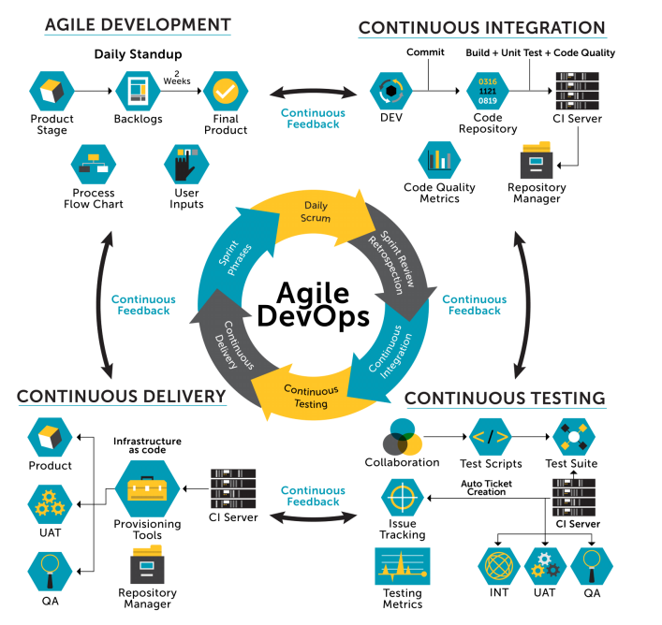

Slide 19
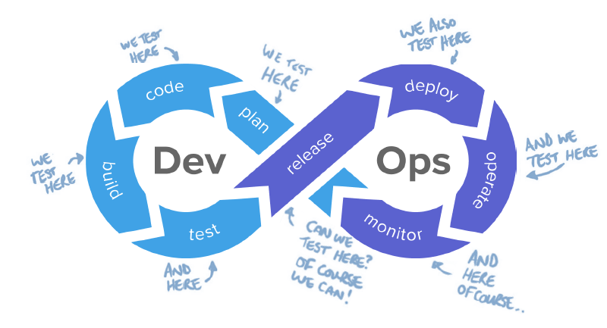
Continues testing
Continuous Testing is a software testing type that involves testing the software at every stage of the software development life cycle
Continuous testing is one of a set of capabilities that drive higher software delivery and organizational performance
https://www.guru99.com/continuous-testing.html

Slide 20
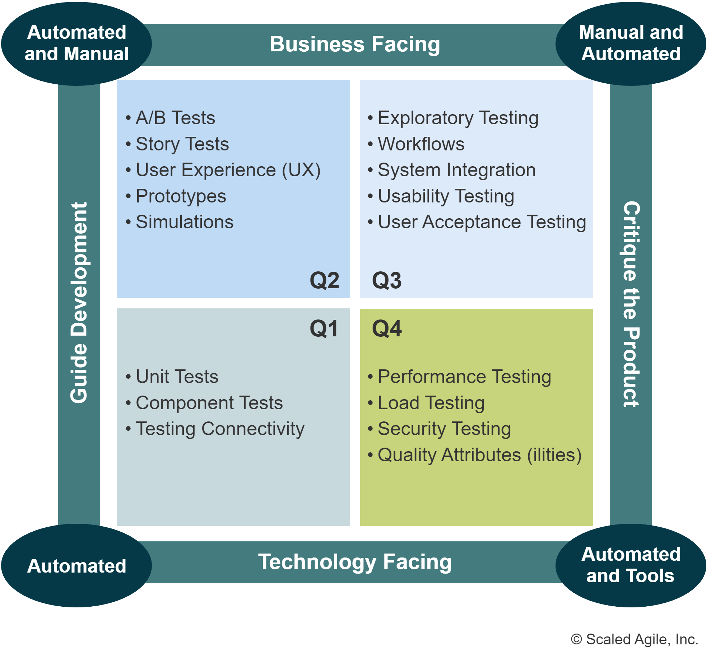
Agile Continuous Testing

Slide 21
Agile Continuous Testing
Q1 – contains unit and component tests.
To confirm that the system works as agreed,
Tests are written to run before and after code changes.
In software, this is largely the home of TestDriven Development (TDD).

Slide 22
Agile Continuous Testing
Q2 – contains functional tests:
user acceptance tests for stories, features, and capabilities, to validate that they work the way the Product Owner (or Customer/user) intended.
Feature-level and capability-level acceptance tests confirm the aggregate behavior of many user stories.

Slide 23
Agile Continuous Testing
Q3 – contains System-level acceptance tests
Contains system-level acceptance tests to validate that the behavior of the whole system meets usability and functionality requirements, including scenarios that are often encountered during system use.
They involve users and testers engaged in real or simulated deployment scenarios, these tests are often manual.
They’re frequently the final system validation before delivery of the system to the end-user.

Slide 24
Agile Continuous Testing
Q4 contains systems qualities test
Contains system qualities testing to verify the system meets its Nonfunctional Requirements (NFRs),
Typically, they’re supported by a suite of automated testing tools (such as load and performance) designed specifically for this purpose.
Since any system changes can violate conformance with NFRs, they must be run continuously, or at least whenever it’s practical.
https://scaledagileframework.com/agile-testing/

Slide 25
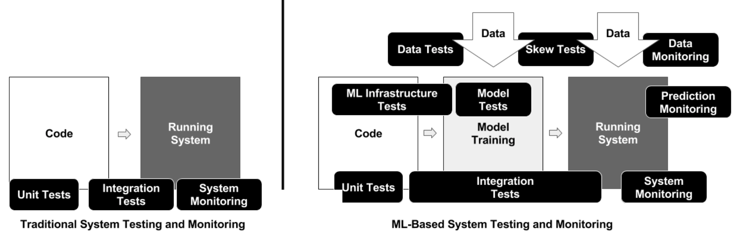
MLOps Testing

Slide 26
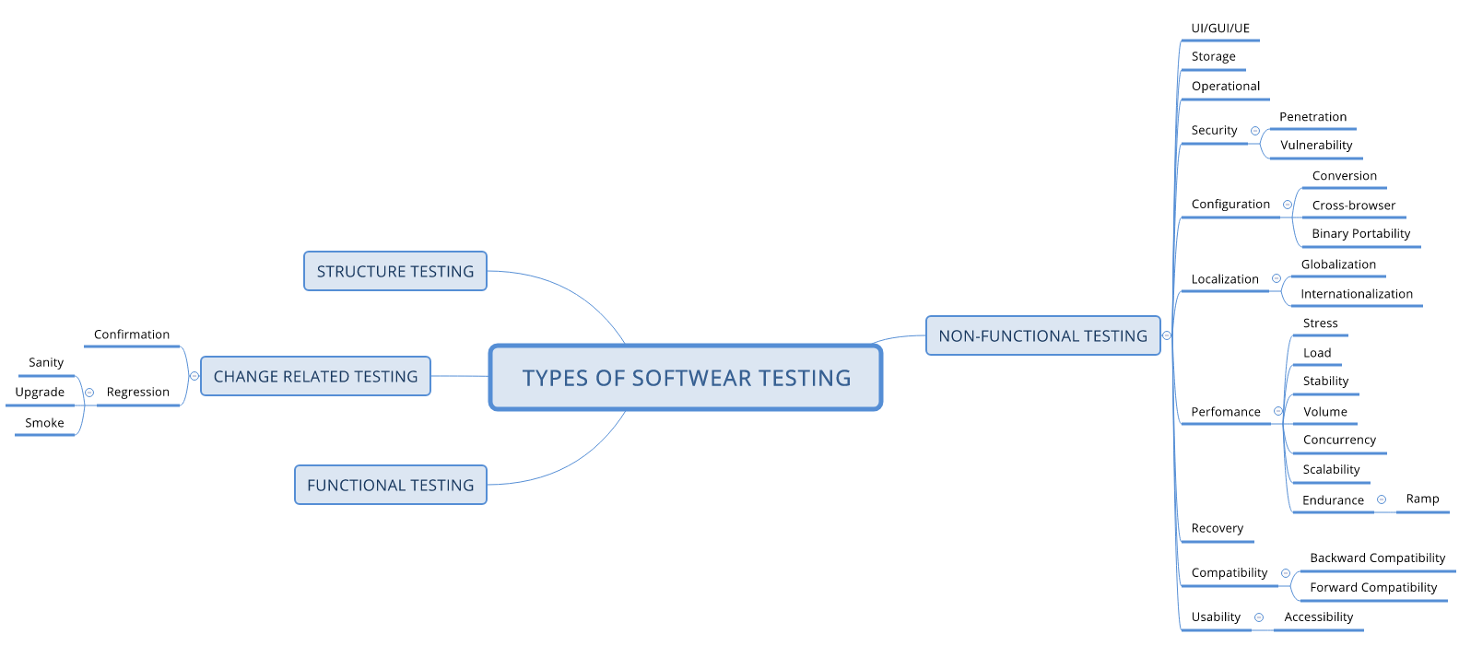
Testing types I
Alpha Testing
Acceptance Testing
Ad-hoc Testing
Accessibility Testing
Beta Testing
Back-end Testing
Browser Compatibility Testing
Backward Compatibility Testing
Black Box Testing
Boundary Value Testing
Branch Testing
Comparison Testing
Compatibility Testing
Component Testing
End-to-End Testing
Equivalence Partitioning

Slide 27
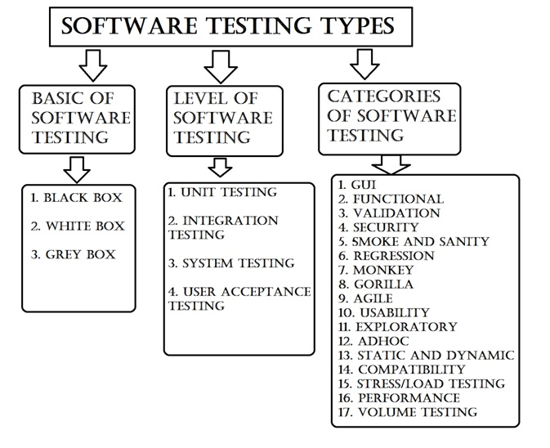
Testing types II
Example Testing
Exploratory Testing
Functional Testing
Graphical User Interface (GUI) Testing
Gorilla Testing
Happy Path Testing
Incremental Integration Testing
Install/Uninstall Testing
Integration Testing
Load Testing
Monkey Testing
Mutation Testing
Negative Testing
Non-Functional Testing

Slide 28
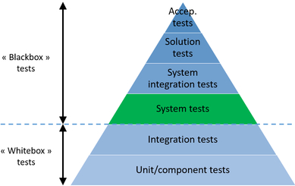
Testing types III
Performance Testing
Recovery Testing
Regression Testing
Risk-Based Testing (RBT)
Sanity Testing
Security Testing
Smoke Testing
Static Testing
Stress Testing
System Testing
Unit Testing
Usability Testing
Vulnerability Testing
Volume Testing
White Box Testing

Slide 29
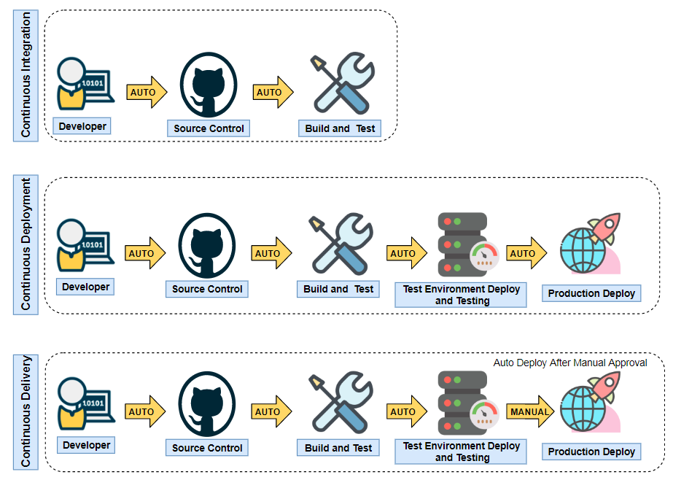
Continuous Integration vs Continuous Deployment vs Continuous Delivery

Slide 30
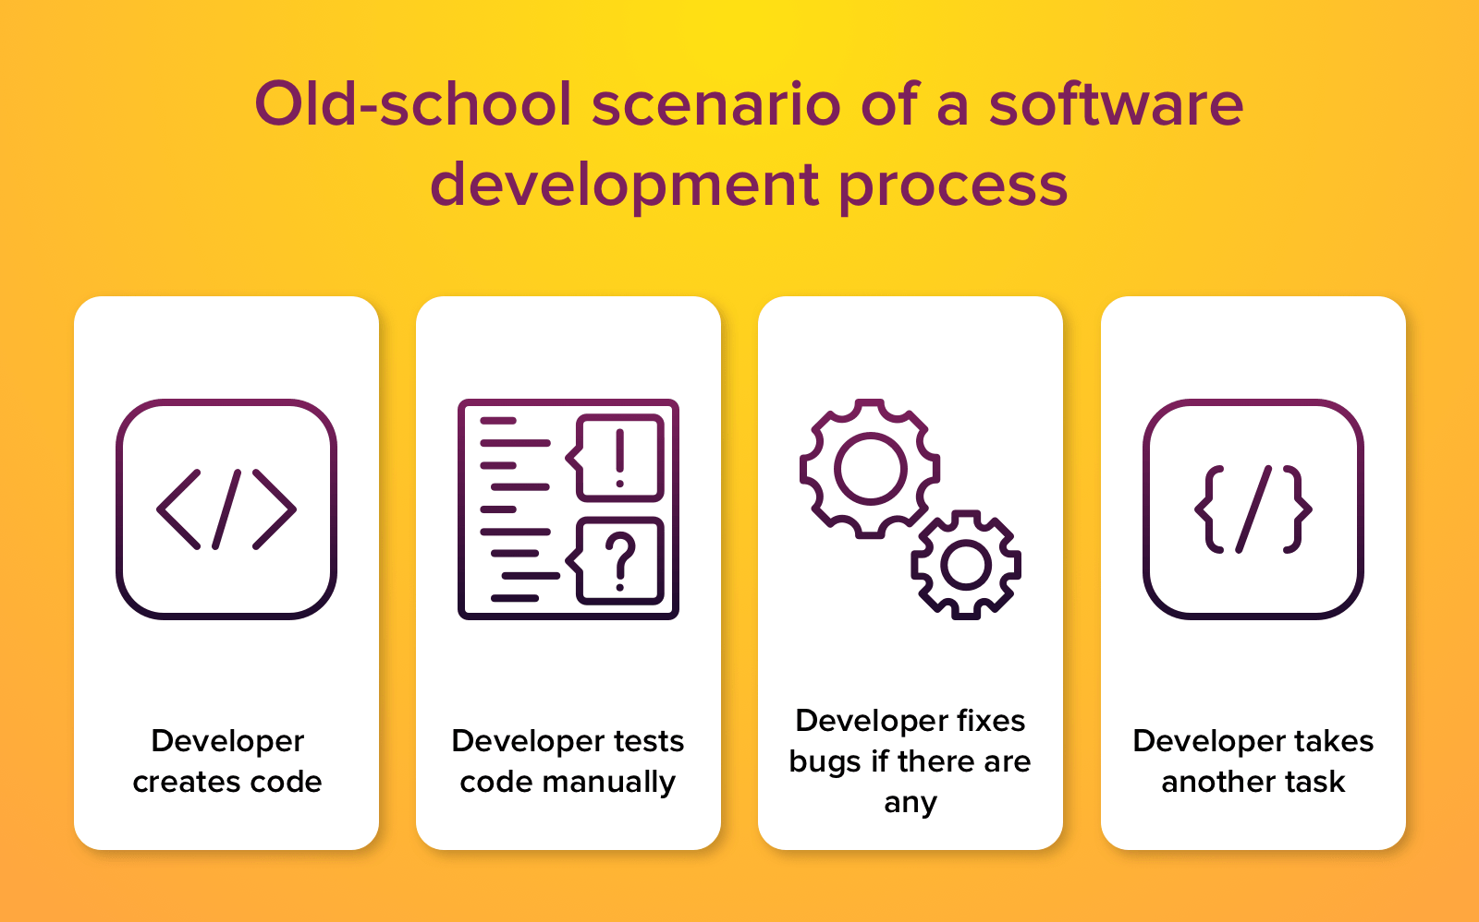
How developers worked before CI

Slide 31
Definition of CI
Members of team integrate their work frequently - at least daily. Each integration is verified by automatic build and test
Martin Fowler
https://www.martinfowler.com/articles/continuousIntegration.html

Slide 32
Continuous Integration (MartinFowler)
“ . . . a software development practice where members of a team integrate their work frequently, usually each person integrates at least daily—leading to multiple integrations per day.
Each integration is to detect integration errors as quickly as possible.
Many teams find that this approach leads to significantly reduced integration problems and allows a team to develop cohesive software more rapidly”
https://www.martinfowler.com/articles/continuousIntegration.html

Slide 33
Definitions of CI
Developers merge their changes to master as often as possible. Changes are validated by automatic build and test
In software engineering, continuous integration(CI) is the practice of merging all developers' working copies to shared main line several times a day.

Slide 34
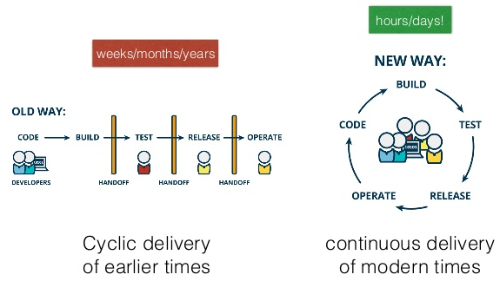
Continuous Integration
Each check-in is then verified by an automated build,
allowing teams to detect problems early.

Slide 35
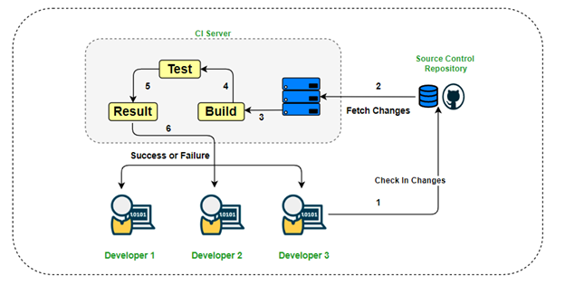
Continuous Integration
A development practice

Slide 36
CI principles
Maintain a code repository
Automate the build
Make the build self-testing
Everyone commits to the baseline every day
Every commit (to baseline) should be built
Keep the build fast
Test in a clone of the production environment
Make it easy to get the latest deliverables
Everyone can see the results of the latest build
Automate deployment

Slide 37
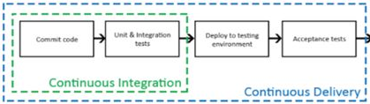
Continuous Integration and Continuous Delivery
Continuous delivery (CD) is a software engineering approach in which teams:
produce software in short cycles,
ensuring that the software can be reliably released at any time
when releasing the software, without doing so manually
releasing software to the test or production environment.

Slide 38
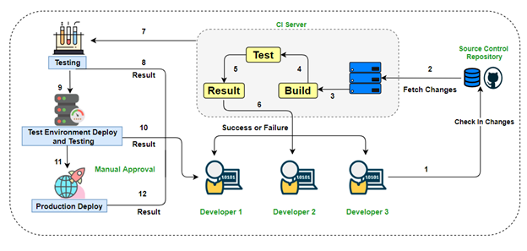
Continuous Delivery

Slide 39
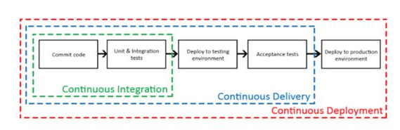
Continuous Integration and Continuous Deployment
CI, CD and CD are practices designed to help increase the speed of development and the release of well-tested products.
Continuous deployment is a software engineering approach in which software functionalities are delivered frequently through automated deployments.
releasing software to production automatically without human intervention

Slide 40
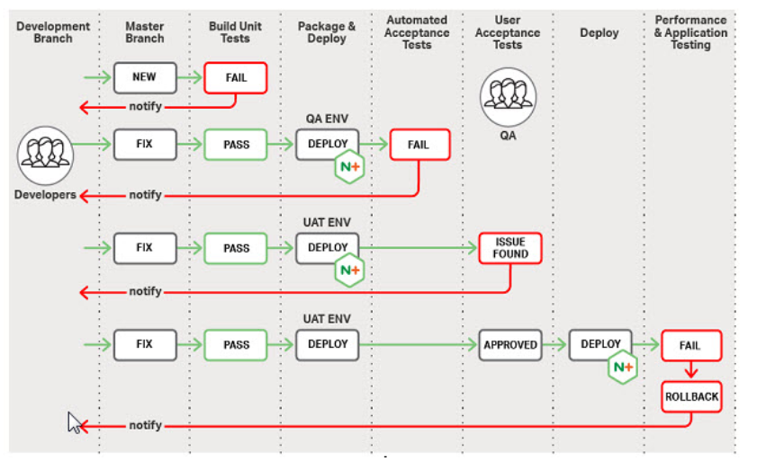
Sequence diagram to show the working of a typical pipeline
https://www.devopsuniversity.org/cicd-and-devops/
Notes:
For a successful CICD implementation, all stakeholders need to work in collaboration, taking complete ownership of their respective tasks and responsibilities, ensuring the integrity of application.
Developers code the business logic and test them through unit tests.
Quality Engineers maintain product quality, review completed features and write end-to-end acceptance tests.
Business Analysts and Owners interact with actual users and create relevant use cases. They coordinate and review results from user acceptance tests to validate the functionality and create new test cases, if required, based on feedback.
Operations (Ops)/DevOps Engineers ensure that the product/ application is available to users at the desired time. They work on the scaling of the process, and other logistics so that the code from developers can smoothly move to the production environment.
Second Principle of CI/CD: Risk Reduction
At each stage in the CI/CD pipeline, stakeholders are responsible to reduce risk ensuring complete quality control.
Developers are accountable to reduce the risk of inaccurate business logic.
QEs are responsible for testing user flow integrity to reduce the risk of broken flows/user cases.
BAs and POs are involved in user acceptance testing to reduce the risk of creating unusable/unwanted features.
Ops/DevOps are involved in CI/CD maintenance, deployment related work and scaling it to reduce the risk of product unavailability.
Short Feedback Loop
Automation is the key in CI/CD. It helps us to get feedback way faster on any newly developed features as the entire process is automated to achieve quicker deployment of functionality to users.

Slide 41
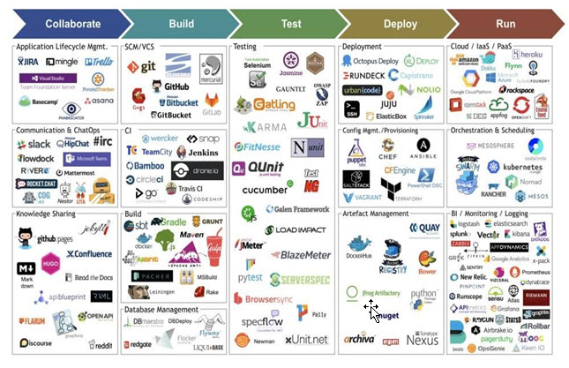
https://www.devopsuniversity.org/cicd-and-devops/

Slide 42
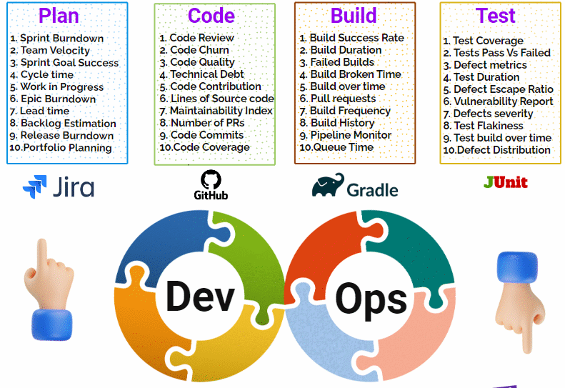
DEVOPS metrics I

Slide 43
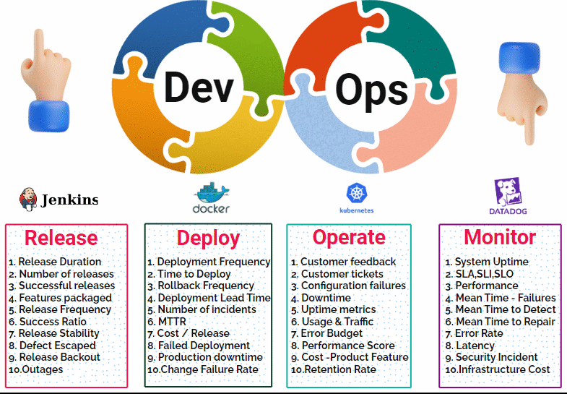
DEVOPS metrics II

Slide 44
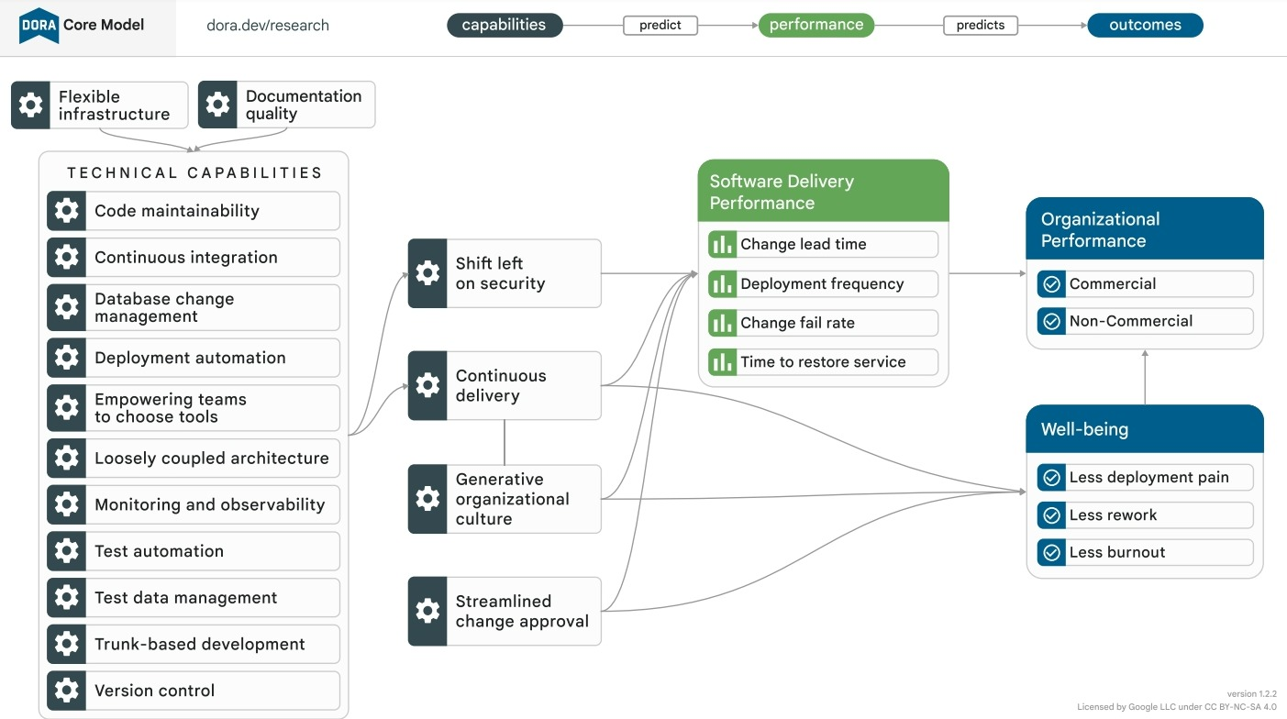
DORA model
https://dora.dev/

Slide 45
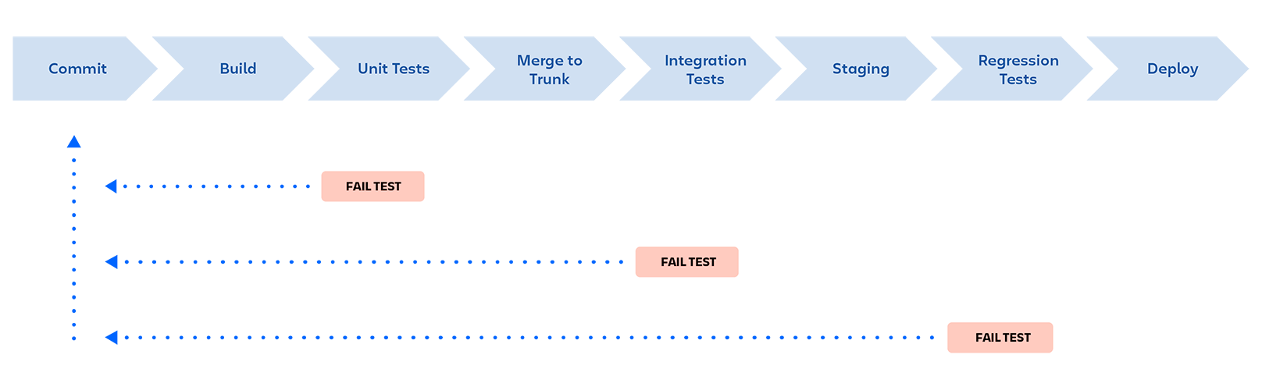
Pipeline definition
The deployment pipeline is an automated manifestation of your process for getting software from version control into hands of your users.
A DevOps pipeline is a set of automated processes and tools that allows developers and operations professionals to collaborate on building and deploying code to a production environment

Slide 46
Build pipeline
Build code
Unit tests
Integration unit tests
Code quality check (sonarqube),
Vulnerability scan of open source dependencies (snyk, blackduck),
Code security check (fortify)
Notes:
Geras build pipeline papildomai turetu turet:

Slide 47
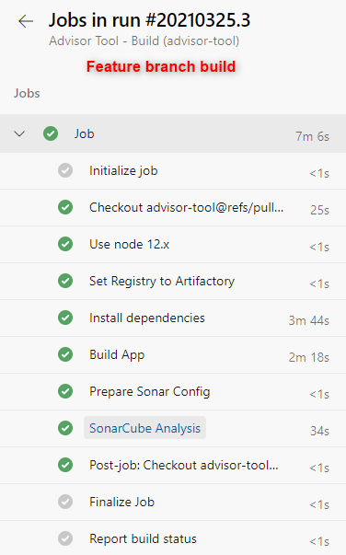
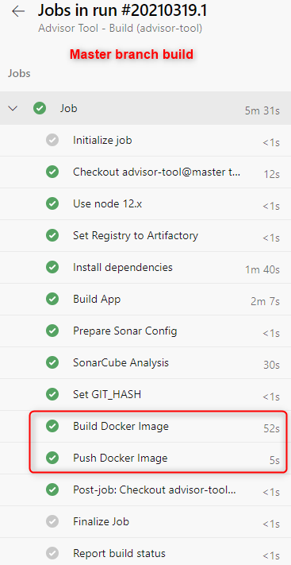
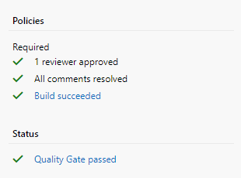
Different builds steps for different branches
Use PR policies to avoid direct commits to master branch, or broken code commits

Slide 48
CI patterns I
Check in code as frequently as possible:
commit and puch code as frequently as possible
split features into smaller tasks
Changes committed to the mainline are applied to each branch on at least a daily basis
short lived branches per task

Slide 49
CI patterns II
3. Fixing broken build takes priority
4. Test coverage:
when discovering a bug, always add tests that cover it;
Including tests with all new code
5. Notify developers of broken build
6. Pair programming or asynchronous code reviews after commit

Slide 50
Pipeline Architecture
Pipelines are the fundamental building blocks for CI/CD
A pipeline is one or more stages that describe a CI/CD process.
Stages are the major divisions in a pipeline:
"Build this app,"
"Run these tests,"
"Deploy to preproduction"

Slide 51
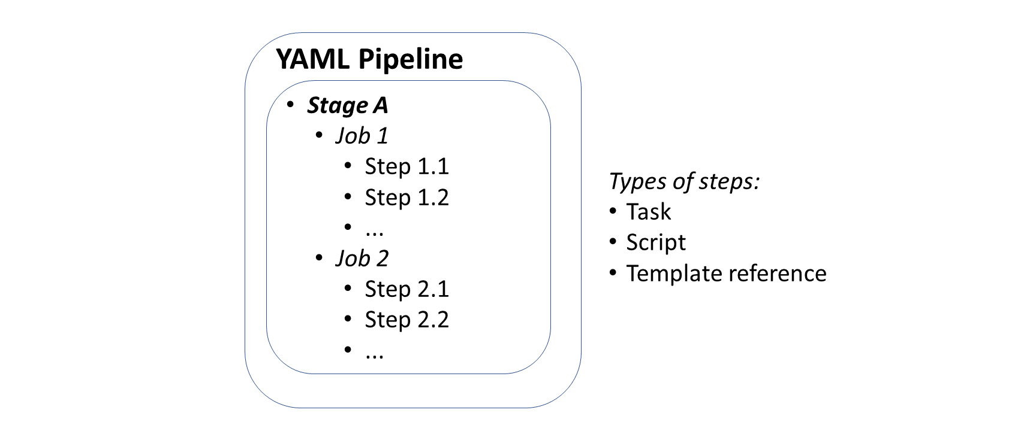
Pipeline Architecture
A stage is one or more jobs:
which are units of work assignable to the same machine

Slide 52
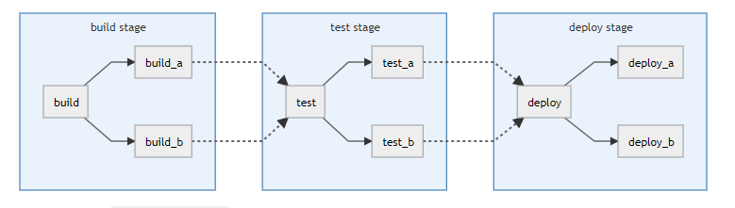
Basic Pipelines
It runs everything in the build stage concurrently, and once all of those finish, it runs everything in the test stage the same way, and so on
It's not the most efficient, and if you have lots of steps it can grow quite complex, but it‘s easier to maintain
Good for straightforward projects where all the configuration is in one easy to find place.
https://docs.gitlab.com/ee/ci/pipelines/pipeline_architectures.html

Slide 53
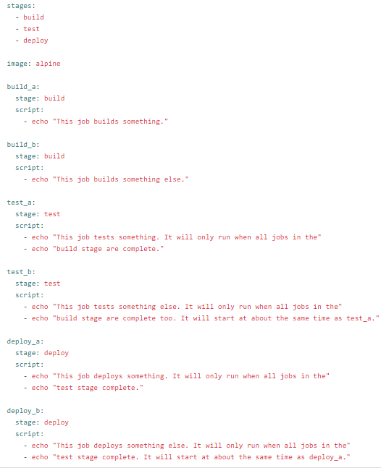
Basic Pipelines

Slide 54
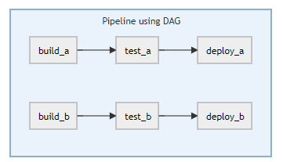
Directed Acyclic Graph Pipelines
If efficiency is important to you
You want everything to run as quickly as possible
Good for large, complex projects that need efficient execution.

Slide 55
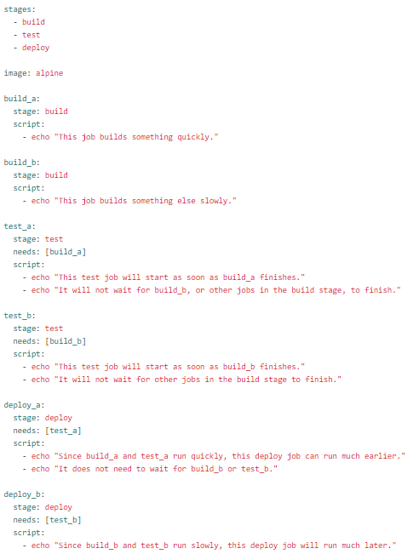

Directed Acyclic Graph Pipelines

Slide 56
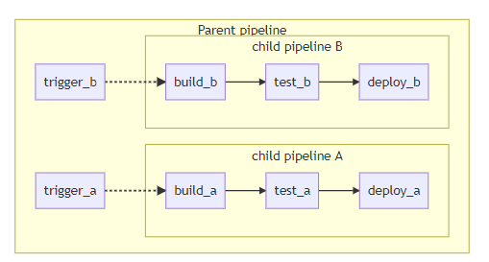
Child/Parent Pipelines
Good for mono repos and projects with lots of independently defined components.

Slide 57
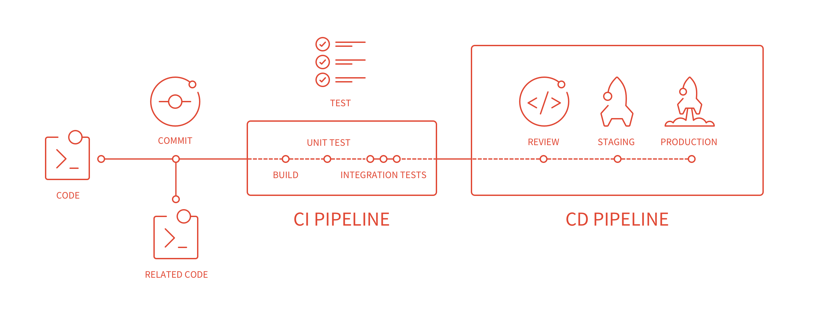
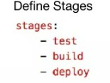
GitLab Pipeline

Slide 58
GitLab
https://studgit.vilniustech.lt/users/sign_in
GitLabCI/CD is a tool for software development using the continuous methodologies:
Continuous Integration (CI)
Continuous Delivery (CD)
Continuous Deployment (CD)

Slide 59

GitLab Pipeline
https://docs.gitlab.com/ee/ci/quick_start/

Slide 60
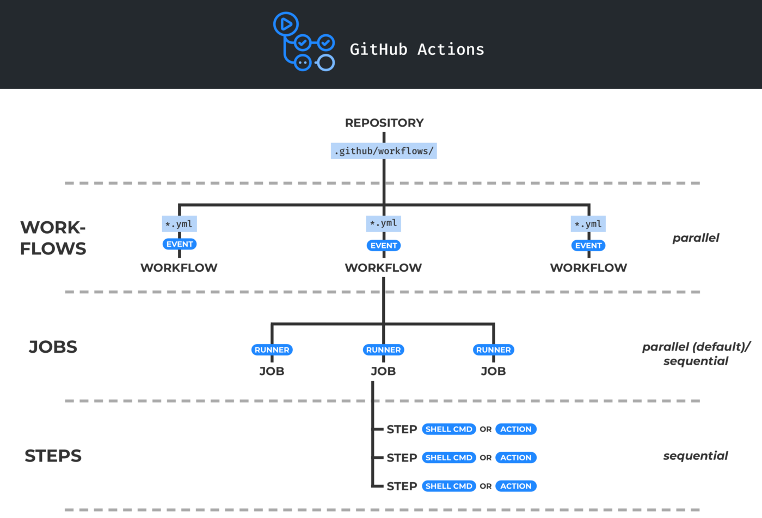
Github Action
https://docs.github.com/en/actions/learn-github-actions/understanding-github-actions

Slide 61
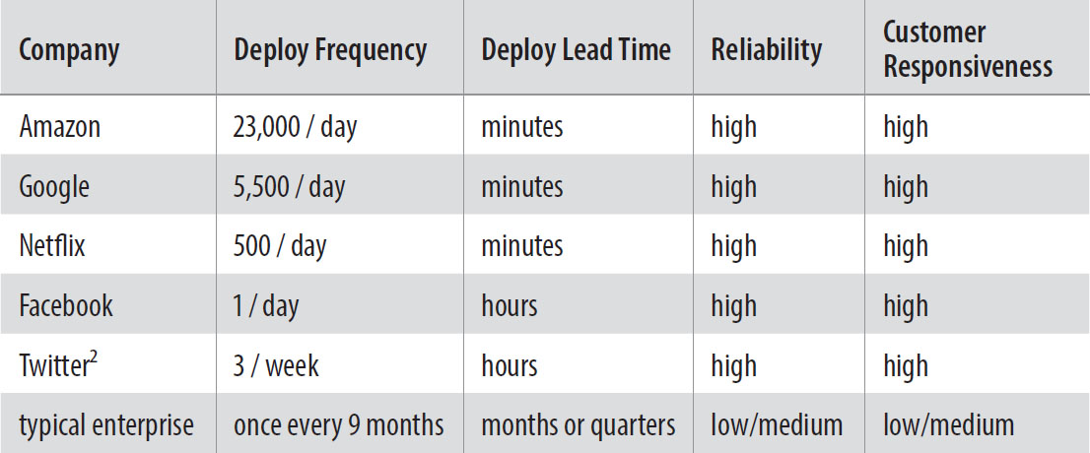
DevOps Statistics
The Phoenix Project [Book]

